Slide 1

Malnad College of Engineering Hassan – 573202, Karnataka (An Autonomous college Affiliated to VTU) Project Phase I Presentation (22EC604) on
Project Title
"Development of a Hardware-Accelerated Gaming System on FPGA with Embedded Al and Entropy-Driven Randomness Generation"
Department of Electronics & Communication Engineering
(Accredited by NBA under Tier-I)
Presented By | Under the Guidance of Dr. Murthi Mahadeva Naik G Professor Dept of E and C MCE. Hassan
Name 1 | USN 1
Ananya S | 4MC22EC011
Kiran | 4MC22EC049
Monisha R | 4MC22EC062
Virupakshayya | 4MC22EC119

Slide 2
Content:
⁠Introduction
⁠Literature Survey
⁠Problem Statement
⁠Objective
⁠Methodology
Flow graph
Expected Outcome
⁠Components Required
⁠References

Slide 3
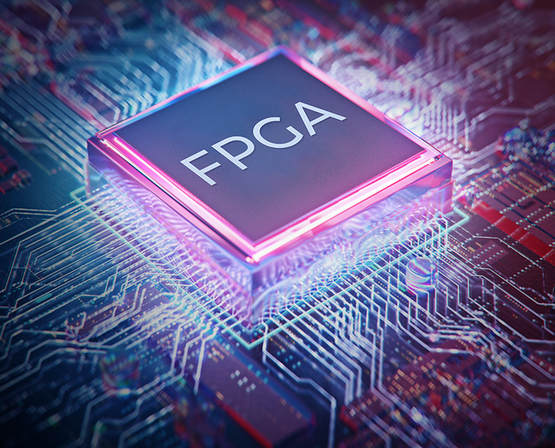
Introduction :
The project focuses on designing and implementing strategy-based games like Lemmings and Blokus using FPGA hardware (Intel Altera DE10-Lite).
It aims to overcome the limitations of software-based games by providing low latency, high performance, and real-time execution using Verilog HDL.
Artificial Intelligence (AI) algorithms such as Monte Carlo Tree Search and FSM or combination of Greedy, FSM and C-ROPUF are integrated to make the gameplay more intelligent and challenging.
A custom Cascading Ring Oscillator PUF (C-ROPUF) is used to introduce randomness and unbiasedness in the game logic.
The project demonstrates the potential of FPGA in building secure, efficient, and intelligent gaming systems, outperforming conventional CPU-based implementations.

Slide 4
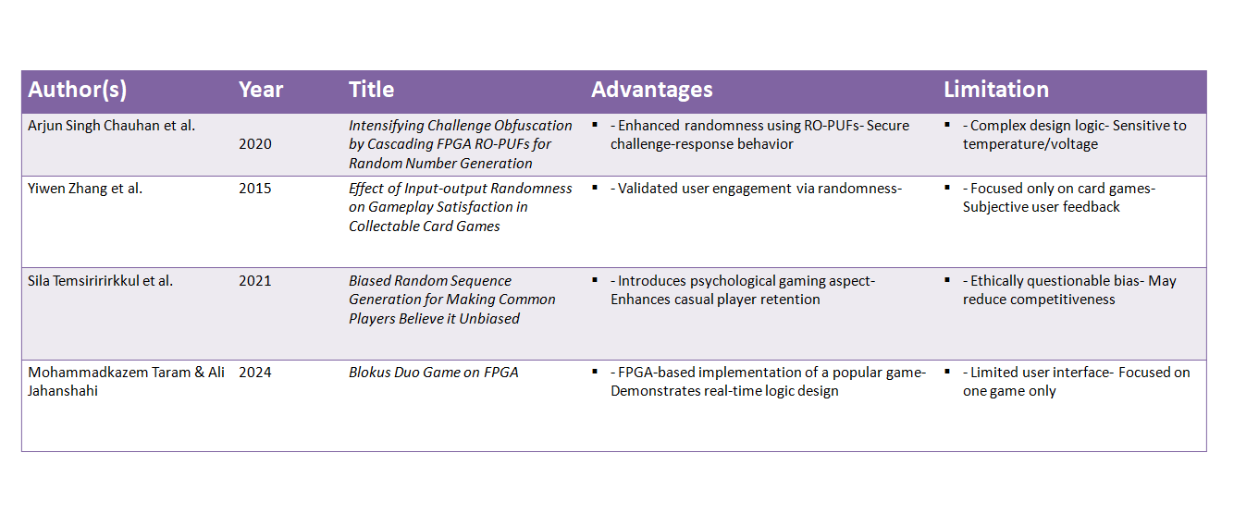
Literature survey:

Slide 5
Problem statement:
1.To design a game on hardware equipment which has less delay compared to the software counter part
2.To introduce unbiasedness, intellectual properties to the game to make it a challenging and intuitive experience for the user.
3.To conduct various levels of performance comparison i.e. with and without randomization and also a high level comparison with software counterparts.

Slide 6
Objective :
1.Design a Simple Game Logic:
Develop a basic digital game (e.g., number guessing, reaction timer, or puzzle game) suitable for implementation on an FPGA.
2.Implement Game on FPGA:
Deploy the game using an FPGA development board (e.g., Xilinx or Intel/Altera), using HDL (Verilog or VHDL) for logic design.
3.Apply Hardware Obfuscation Techniques:
Introduce logic obfuscation strategies such as logic locking, FSM obfuscation, and dummy logic insertion to protect the game’s internal design.
4.Ensure Functionality & Security:
Verify that the obfuscated design retains full game functionality while preventing unauthorized access or reverse engineering.
5.Evaluate Performance Impact:
Assess the trade-offs between security (obfuscation) and hardware resources (timing, power, area) on the FPGA.

Slide 7
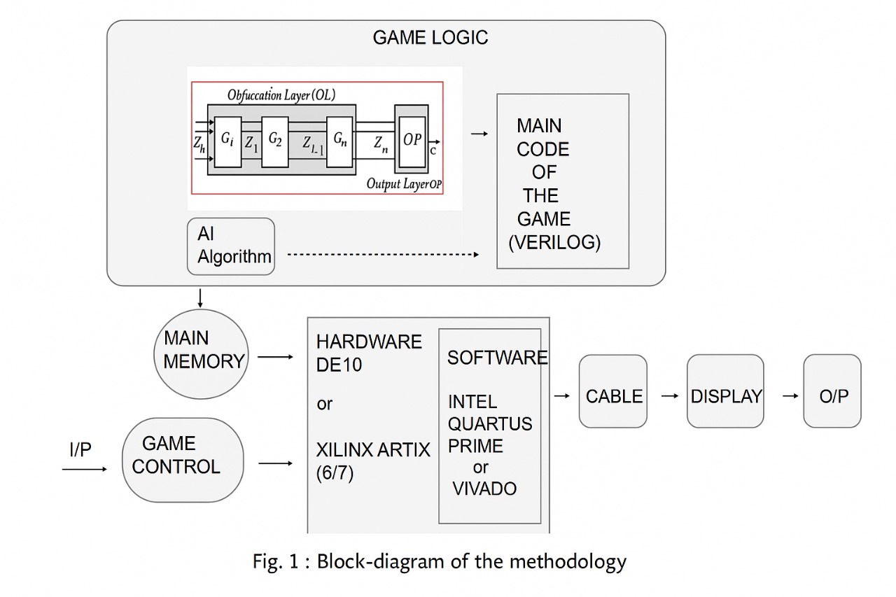
Methodology:

Slide 8
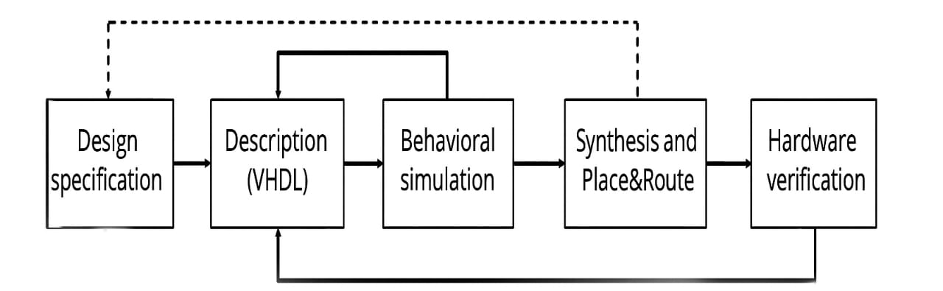
Flow Graph :
Fig.2 Data Flow Diagram
Define system goals, I/Os, frequency, architecture (blueprint of the system).
Write Verilog/VHDL code for each module (e.g., game logic, AI, PUF).
Simulate logic using ModelSim to catch functional bugs early.
Convert HDL to gate-level circuit and map it onto FPGA hardware.
Upload the bitstream to FPGA and test real-time system behavior.

Slide 9
Expected Outcome
A functional FPGA-based gaming system with hardware-accelerated performance.
Reduced game latency and increased frame rate compared to software-only systems.
Modular architecture for easy game and AI model updates.
Demonstration of gameplay with adaptive AI and unpredictable events.Technical documentation, simulation results, and real-time FPGA implementation.
Game obfuscation and security.

Slide 10
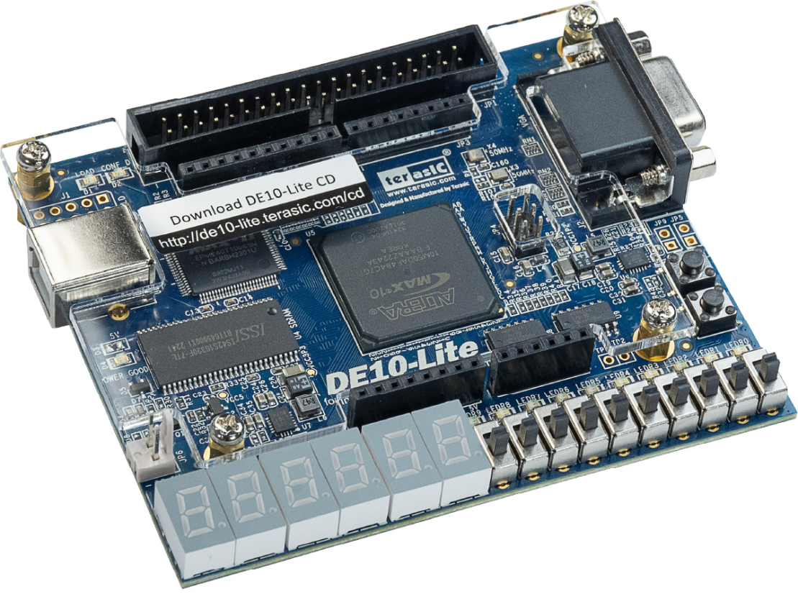
Software requirements
1.Model Sim, Quartus Prime, Visual Studio Code, Jupyter Notebook
2. AI algorithms for gaming like Monte Carlo Tree Search or Combination of Greedy, FSM and C-ROPUF
3. A digital VLSI design of PUF using Verilog
Hardware requirements:
1.FPGA Kit (Intel Altera DE-10 LITE/ sparten 3)

Slide 11
References:
[1] Arjun Singh Chauhan, Vineet Sahula, A. S. Mandal, Abhigyan Dutta, “Intensifying Challenge
Obfuscation by Cascading FPGA RO-PUFs for Random Number Generation”, IEEE, 2020.
[2] Yiwen Zhang Diego, Monteiro Hai-Ning, LiangJieming Ma, Nilufar Baghaei, “Effect of Input output Randomness on Gameplay Satisfaction in Collectable Card Games “, IEEE, 2021.
[3] Sila Temsiririrkkul, Hisamitsu Nomura, Kokolo Ikeda, “Biased Random Sequence Generation for
Making Common Players Believe it Unbiased”, IEEE, 2014.
[4] Mohammadkazem Taram, Ali Jahanshahi, “Blokus Duo game on FPGA”, Researchgate Website,
2013.
[5] C. J. Jiménez-Fernández, C. B. Oliva, P. P. Fernández, A. G. Soto, F. E. P. Ordóñez and M. V. Barrero, "Learning VHDL through teamwork FPGA game design," 2020 XIV Technologies Applied to Electronics Teaching Conference (TAEE)

Slide 12
Thank You

